Slide 1
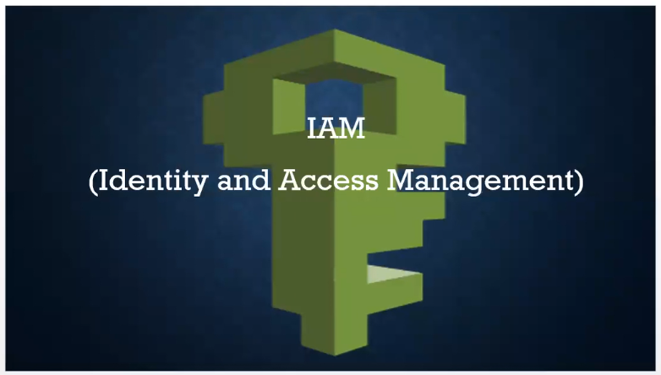

Slide 2
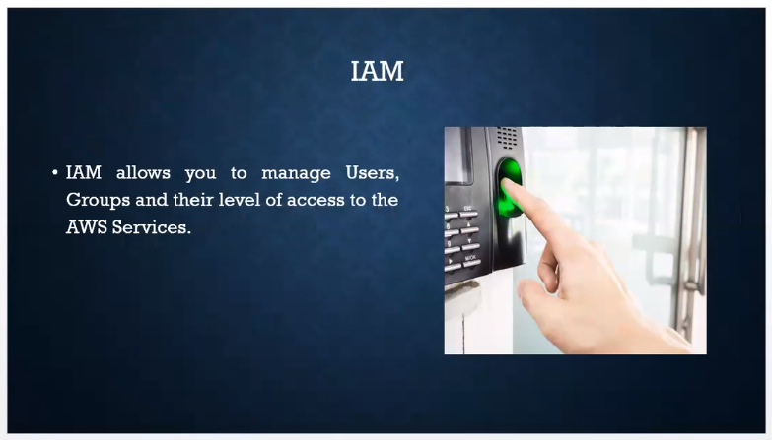

Slide 3
Advantages of IAM
Centralised control of your AWS Account
Shared access to your AWS Account
Granular permissions
Identify federation ( users can login using linkedin , Facebook etc)
Multifactory Authentication ( password and OTP )
Setup password rotation policy ( eg: password will expire every 30 days )

Slide 4
Important terms
Users – End Users ( people )
Groups – Collections of users, under one set of permissions.
Policies – Set of permissions
Roles – We can create roles and assign them to AWS resources

Slide 5
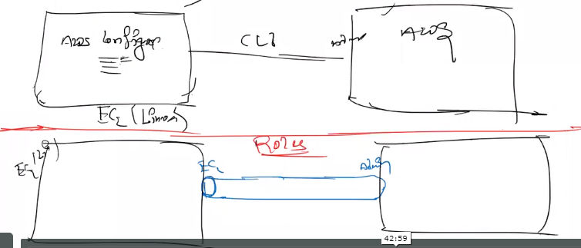
Understanding role

Slide 6
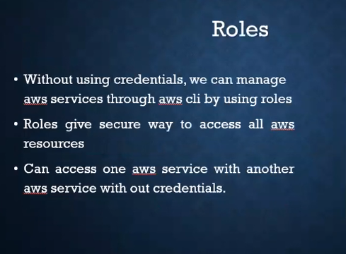

Slide 7
